Slide 1
Outlier Analysis
Gowtham K Jayachandiran

Slide 2
What are outliers in the data?
An outlier is an observation that lies an abnormal distance from other values in a random sample from a population. In a sense, this definition leaves it up to the analyst (or a consensus process) to decide what will be considered abnormal.
Before abnormal observations can be singled out, it is necessary to characterize
normal observations.
data - (2,1,1,3,4,2,1,4,5,6,2,6,8,9,64,1,7,9)
Only one data point is not in the distribution. You could see all data points are within the range of 1-9. But one data point has a value of 64. Which can be considered as an Influential data point.

Slide 3
Box & Whiskerplot
Calculate the median and the quartiles (the lower quartile is the 25th percentile and the upper quartile is the 75th percentile). Assuming that middle 50% of data can’t be an outlier.
Plot a symbol at the median (or draw a line) and draw a box between the lower and upper quartiles; this box represents the middle 50% of the data.
Draw a line from the lower quartile to the minimum point(Q1-1.5(IQR)) and another line from the upper quartile to the maximum point (Q3+1.5(IQR)). Typically a symbol is drawn at these minimum and maximum points.

Slide 5
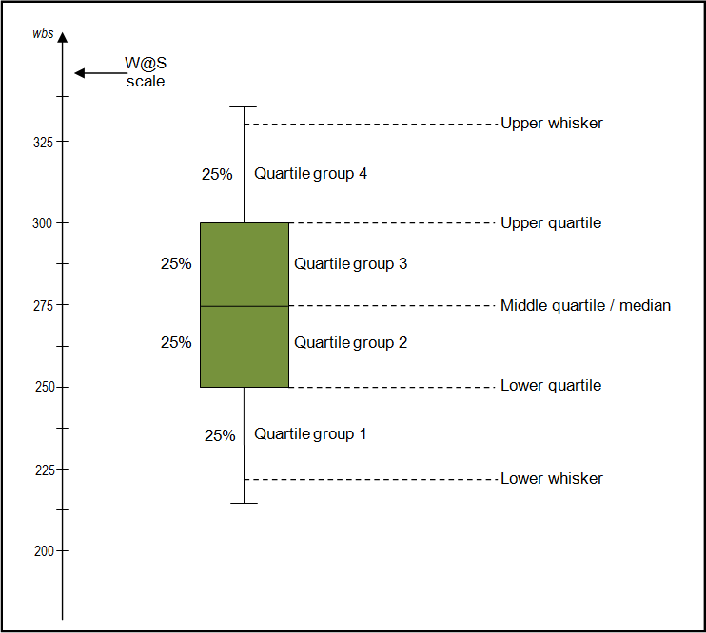
Read this blog: http://informationandvisualization.de/blog/box-plot

